Slide 1
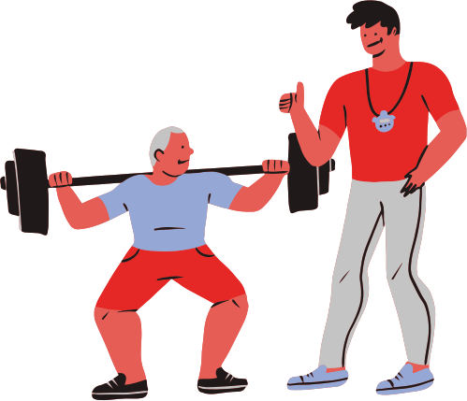
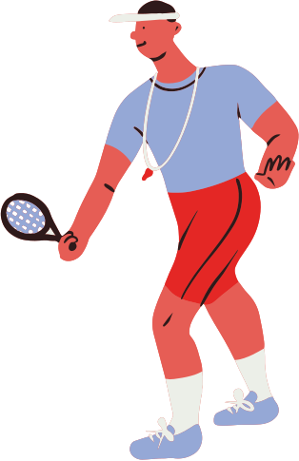

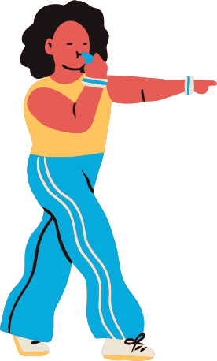

The Effect of Structured Physical Exercises on Improving Alertness Among Participants in the Learning Days 2026 Cohort: A Block-Randomized Controlled Trial.

Slide 2
Structured Exercise Group (SEG)
Musiliu Adeolu Adewole
Roseline Dzekem Dine
Precious Nguher Ifan

Slide 3
Background
Alertness is a state of mental and physical readiness essential for attention, learning, memory, decision-making, and academic performance (Krause et al., 2017).
It is regulated by the body’s sleep pressure, which influence cognitive functioning throughout the day (Borbély et al., 2016).
Before lunchtime, alertness may decline due to inadequate sleep, prolonged cognitive effort and hunger.
Reduced alertness can lead to drowsiness, poor concentration, slower reaction times, and reduced learning and productivity (Lim and Dinges, 2010).
Thus, interventions that enhance alertness during this period are assumed to improve alertness (Krause et al., 2017).

Slide 4
High Level Question
Does short structured physical exercises improve alertness among participants in the learning days 2026 cohort?
SRQ 1
What is the alertness status of participants before and after the intervention?
SRQ 2
Is there a difference in post-intervention alertness status between blocks participants who received the interventions and control?

Slide 5

MIDA
MODEL-
N=20: 9 in the Anglophone block and 11 in the Francophone block
Y= α ₊ +T + X +e
Y𝑖 = 𝛽0 + 𝛽1𝑍𝑖 + 𝑒
Hypothesis:
H₀: Exercise does not improve alertness
H₁: Exercise improves alertness

Slide 6

MIDA
2. Inquiry
Does exercise really help Learning Days 2026 participants perform better in class?
Estimand
Within blocks average size effect
Average effect size among all participants

Slide 7
MIDA-3. Data strategy
He X. et al. (2025), the closest relevant meta-analysis, measured awakeness (energy, arousal, and reduced sleepiness) and reported effect sizes ranging from 0.20 to 0.39.
An assumed effect size of 0.30 was adopted for this study.

Slide 8

MIDA - 3. Data strategy
Treatment group.
Control group
Baseline
Conduct 2 to 3 minutes activity led by facilitator
30 seconds activity
Measure their performance before and after the program.
The outcome alertness was assessed for all at 13:00 PM
Randomization
0 1
E 4 5
F 7 4

Slide 9
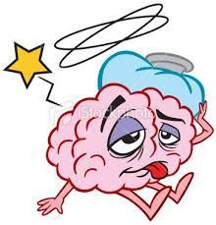

Randamization and Power
0.10
0.10

Slide 10
MIDA
Answer strategy
Compared the exercise group with the control group.
Looked at their performance scores.
Decided whether the exercise group performed better.
Regression model (Alertness ~ Exercise + Block + controls)
Controls: Age, gender, fitness, caffeine, breakfast

Slide 11
Implementation report
Block randomization by language
Facilitators: Group members
.
Ethics-Informed consent
Unit of analysis: Individual participant
Data collection: Paper → Excel → RStudio

Slide 12
Results

Slide 13
Descriptive characteristics of participants (N = 20)
Age Group
Gender

Slide 14
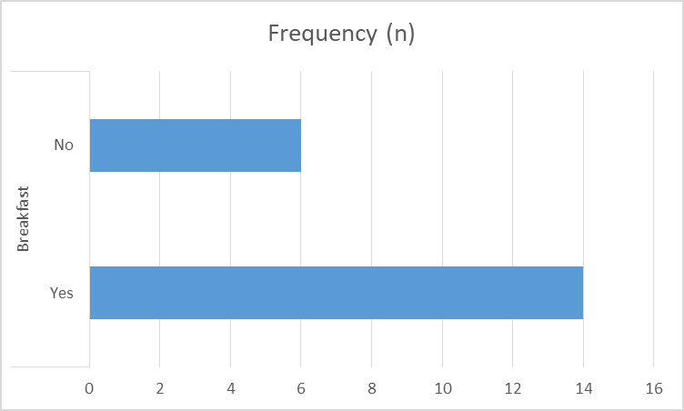
Descriptive characteristics of participants (N = 20)
Physical fitness
Break fast

Slide 15
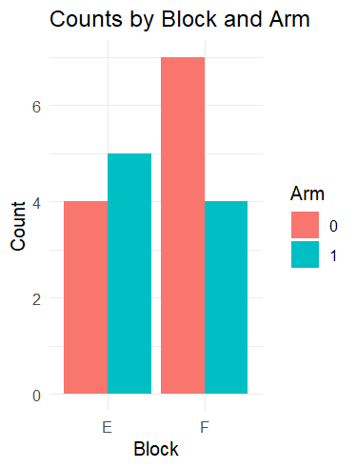
Count by Blocks and Arms
Descriptive characteristics of participants (N = 20)
E =English block- 9
control - 4
Intervention - 5
F = French block - 11
control - 7
Intervention - 4

Slide 16
Regression model (GLM)
Testing of hypothesis
No statistically significant improvement in alertness.
Regression coefficient for intervention = -0.195
p-value = 0.839.

Slide 17
Treatment effect
Testing of hypothesis

Slide 18

Testing of hypothesis

Slide 19
Discussion
Our RCT found a non-significant Average Treatment Effect (ATE), unlike many observational studies that report stronger positive associations between exercise and cognition.
Meta-analyses indicate that acute exercise has a positive but modest effect, influenced by factors such as timing, task type, and exercise intensity.

Slide 20

Bias
Small sample size (n = 20) limited statistical power, increasing the risk of a Type II error (failing to detect a true effect).
Measurement error from subjective responses may have attenuated the estimated treatment effect toward zero, contributing to the non-significant ATE.
Consistency in delivery of intervention

Slide 21
Conclusion & Recommendation
Structured physical exercise produced a small or no reduction in sleepiness.
Our study found no evidence that the intervention improved alertness among participants.

Slide 22

Merci beaucoup !!!

